Slide 1
Smart Care
Team Members:
Sai Nishant Dilly
Vikas Deshpande
Venkatesh Bonageri

Slide 2

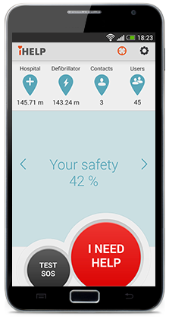

Design Goal And Justification
Promote Health Awareness
Relax, Sit back and Use
Friendly Reminders

Slide 3
Design Goal
Promote Health Awareness
By reminding users about something they have to do
By asking user specific questions formed from a study
Intuitive use of Technology in the form of mobile application to the users
Good for users since they don’t have to travel anywhere nor wait for the appointment
Easy to understand “User Interface” for patients who aren’t tech savvy
Easy reminders for patients

Slide 4
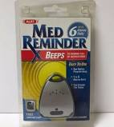
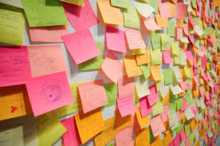

Design Justification - Alternatives
Alternate 1:
Medical Reminder Devices
Alternate 2:
Scattered Sticky Notes to Remind
Alternate 3:
Asking your loved ones to remind

Slide 5
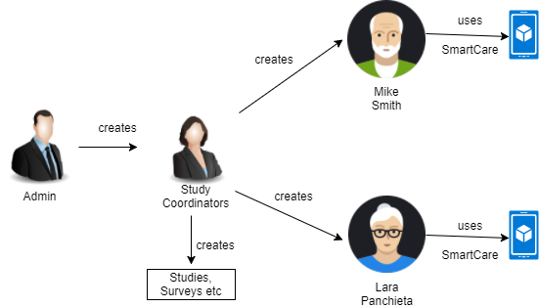
Design Diagram

Slide 6




Personas
Study Cordinaor
“I create users, studies and adds users to them. I will also send surveys, simple questions and informational messages to users”
Mike Smith – 52 year old male Study Coordinator has included Mike in the survey study that he is doing.
Lara Panchieta
Study Coordinator has included Lara in a study and reminds her of some informative answers and asks some simple questions
Administrator
“I create users and study coordinators ”

Slide 7
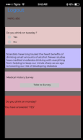
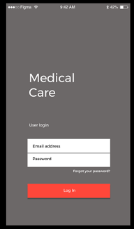
Design Concepts – User Experience

Slide 8
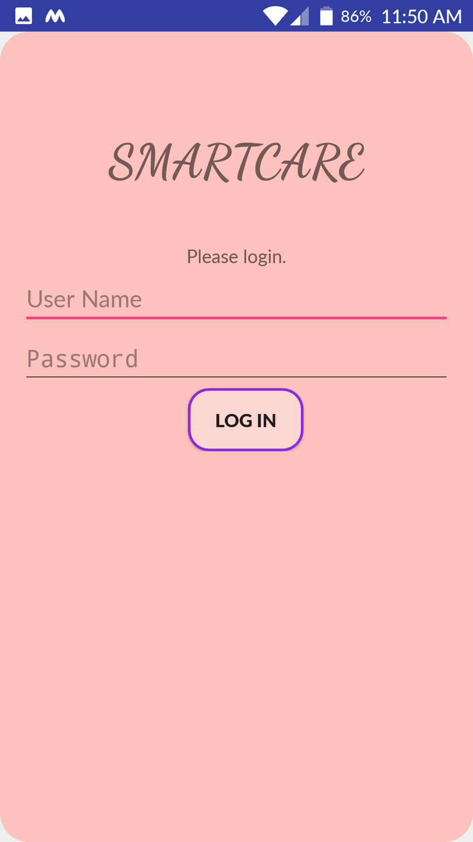
User Login

Slide 9
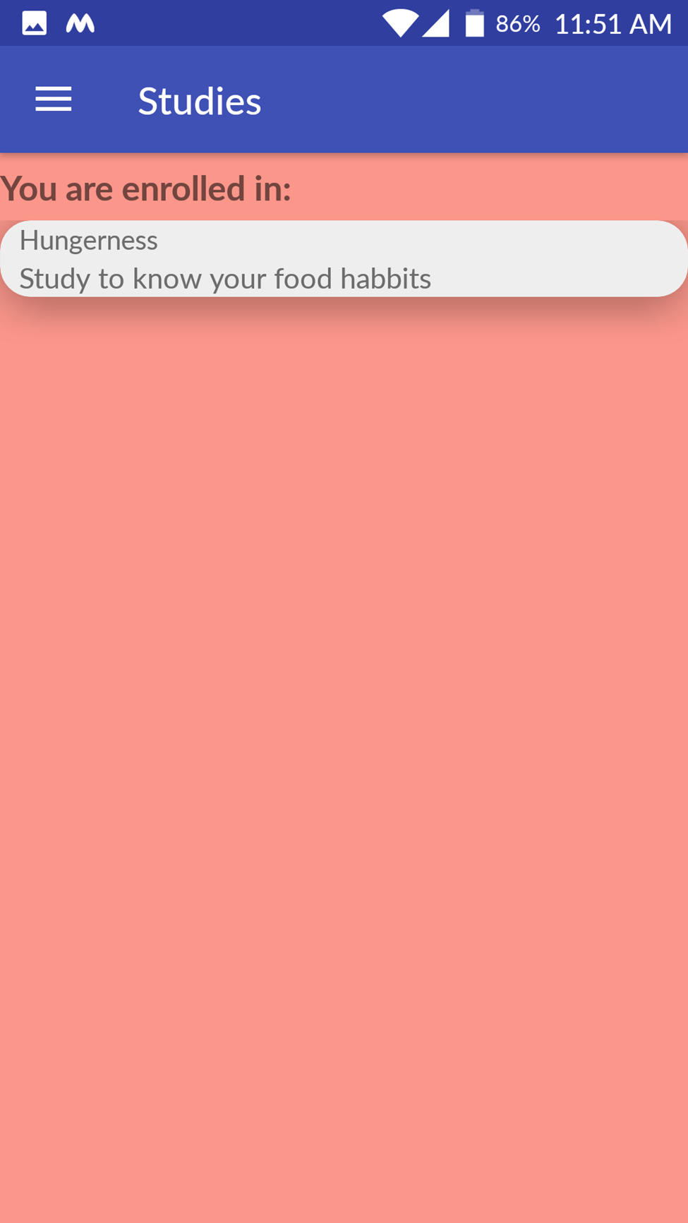
List all the Studies

Slide 10
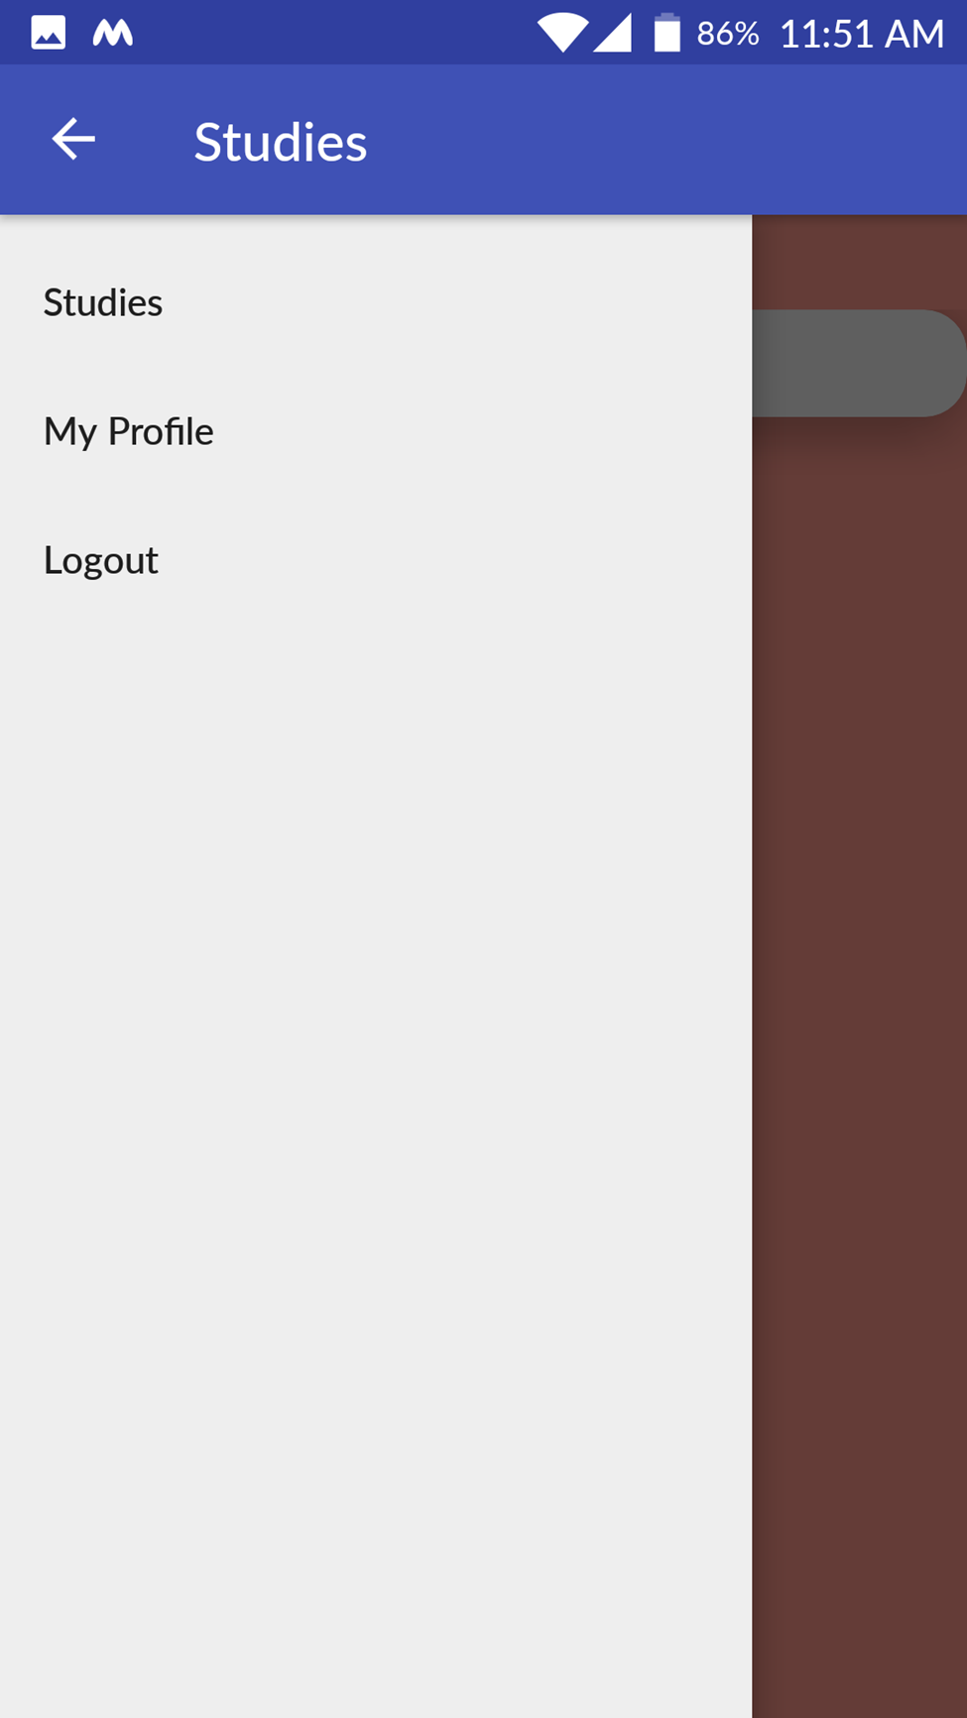
Lnavigation Menu

Slide 11
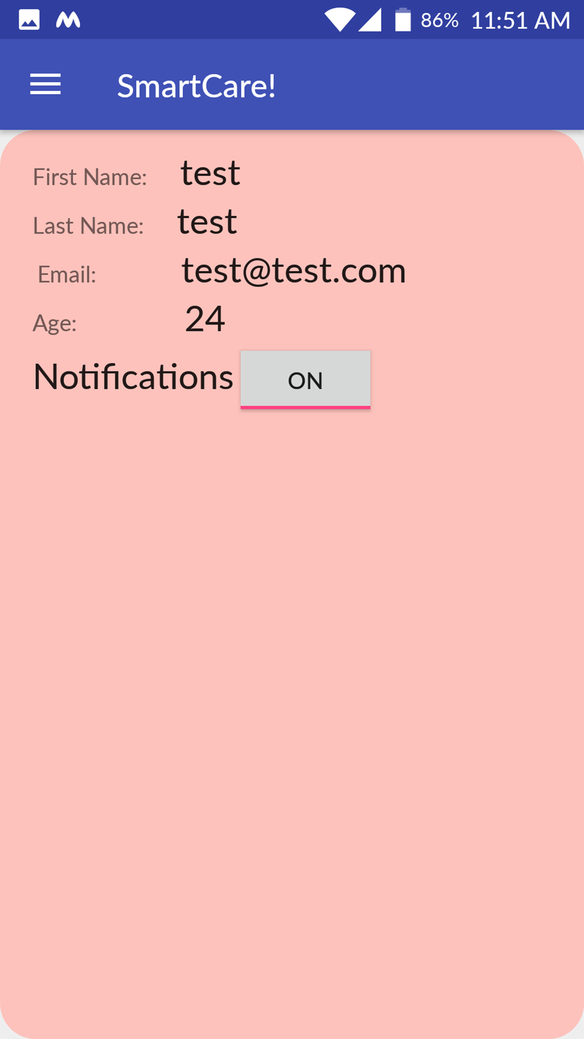
Profile Details

Slide 12
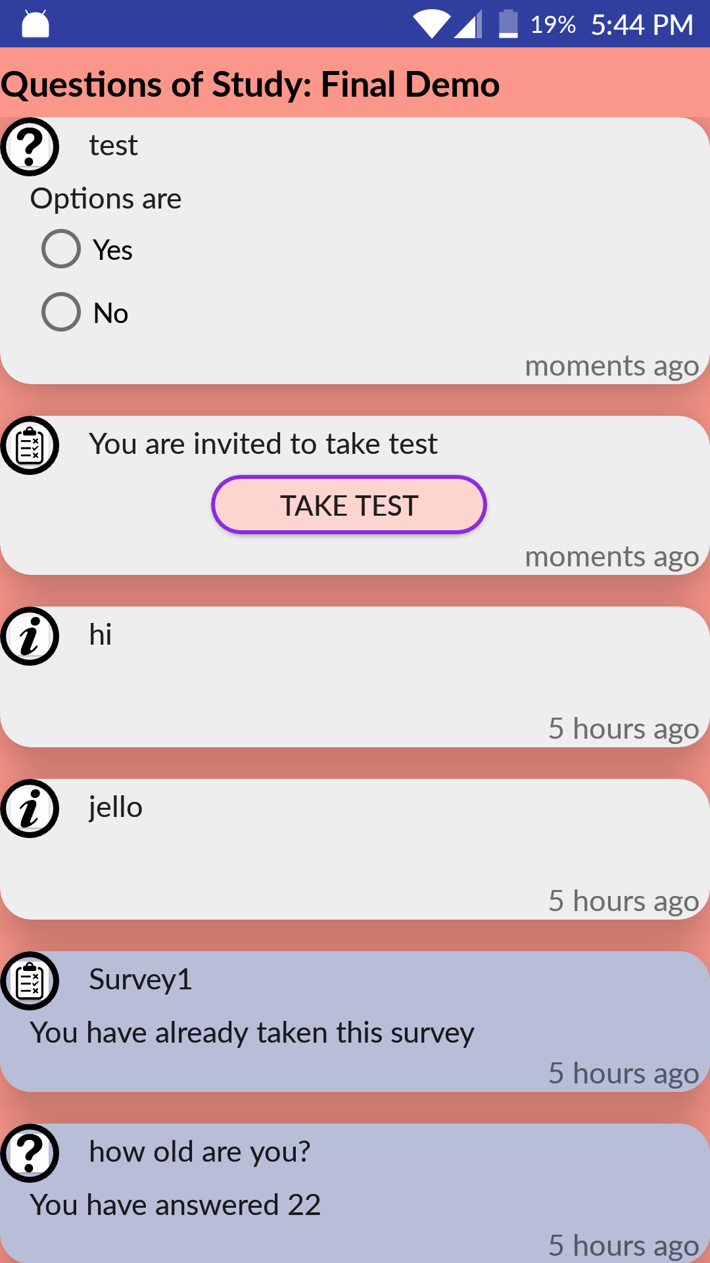
List of question in study

Slide 13
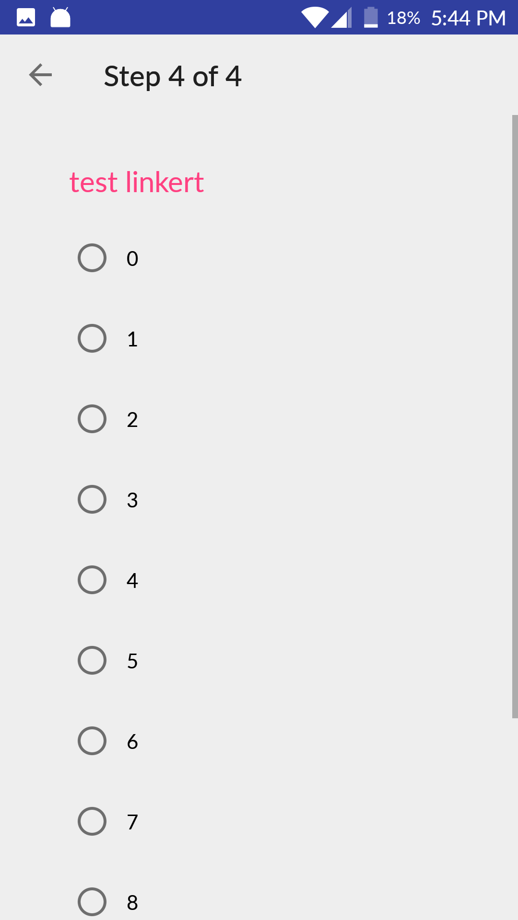
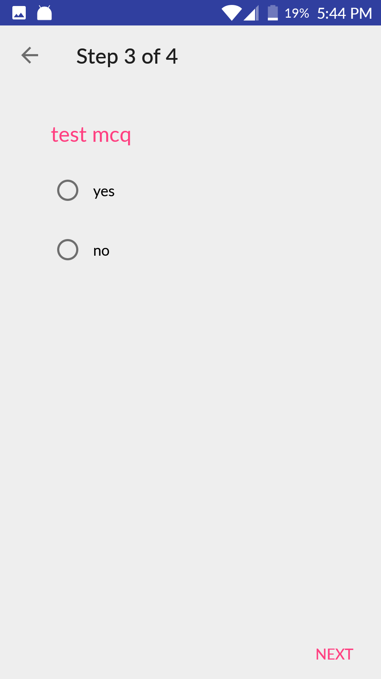
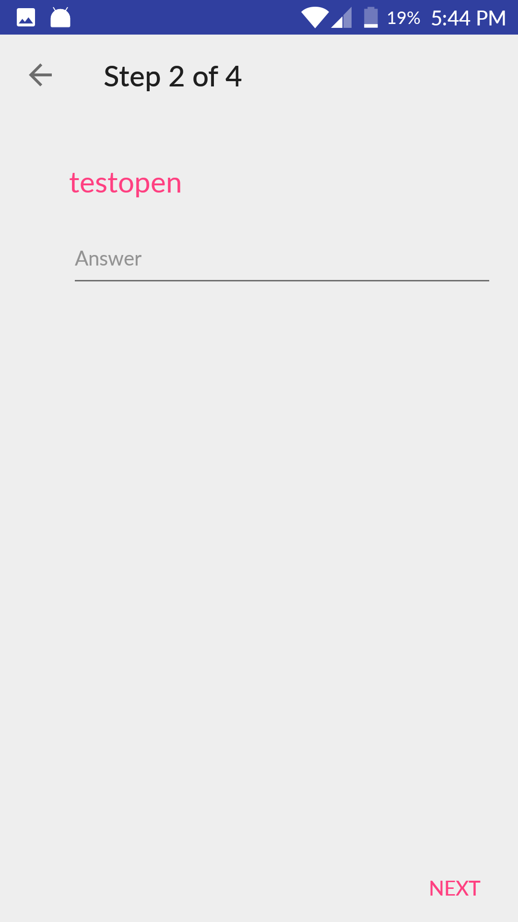
Survey questions

Slide 14
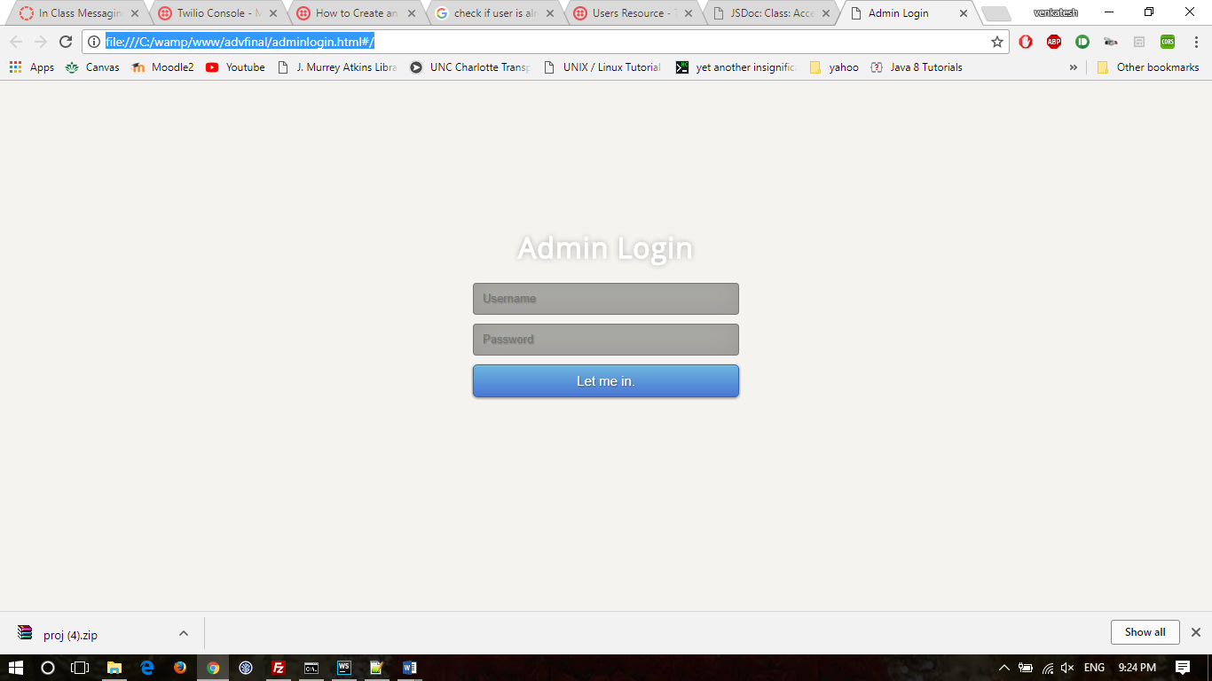
Admin Login

Slide 15
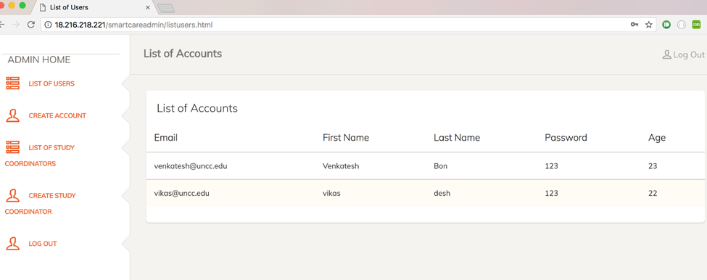
Shows users

Slide 16
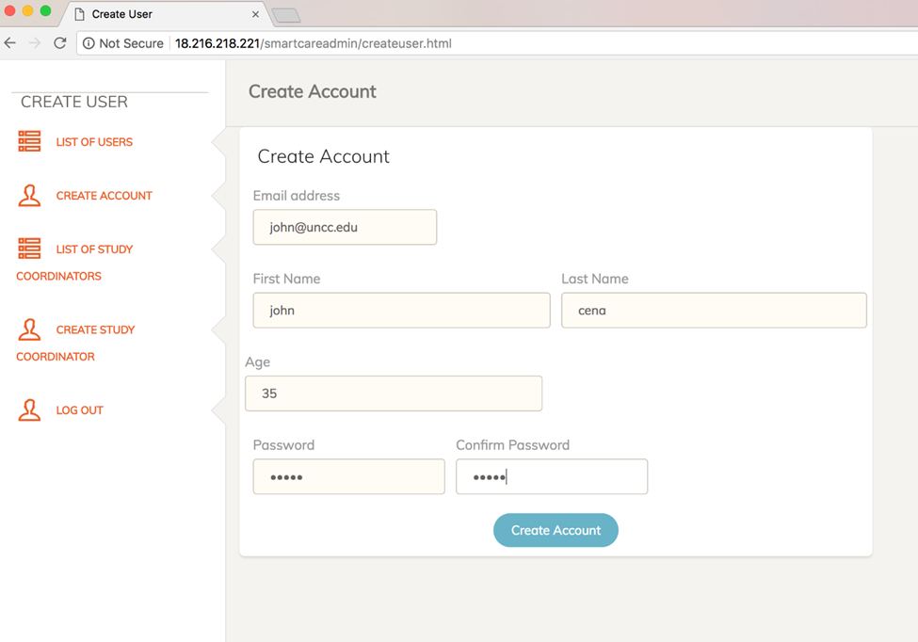
Creation of user

Slide 17
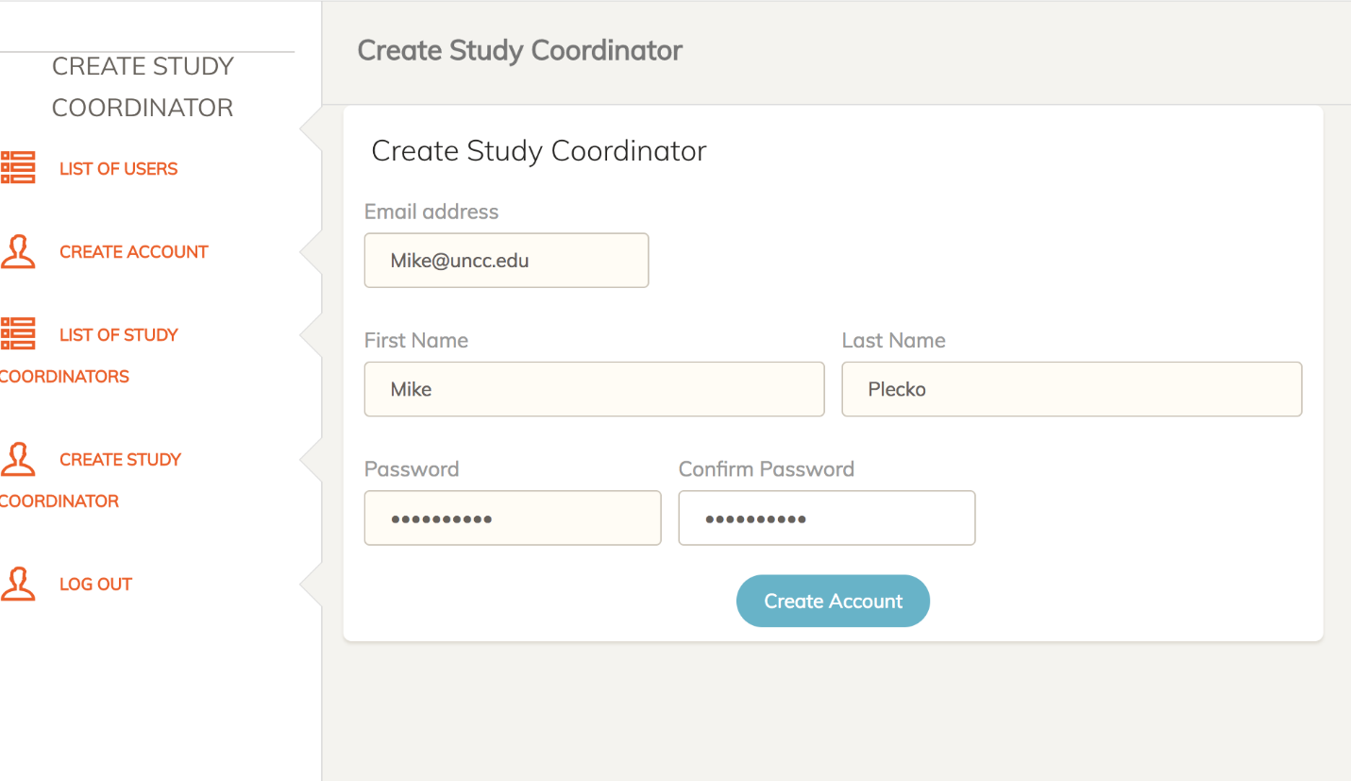
Creation of Study co-ordinator

Slide 18
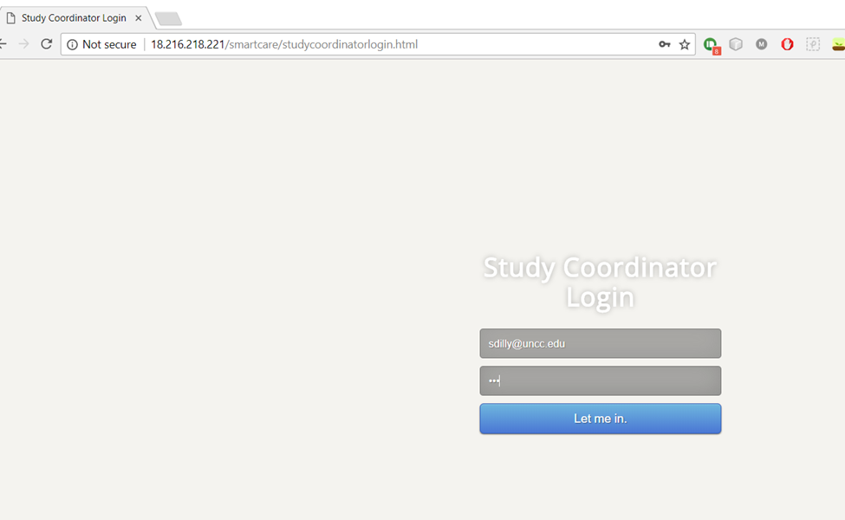
Study Coordinator Login

Slide 19
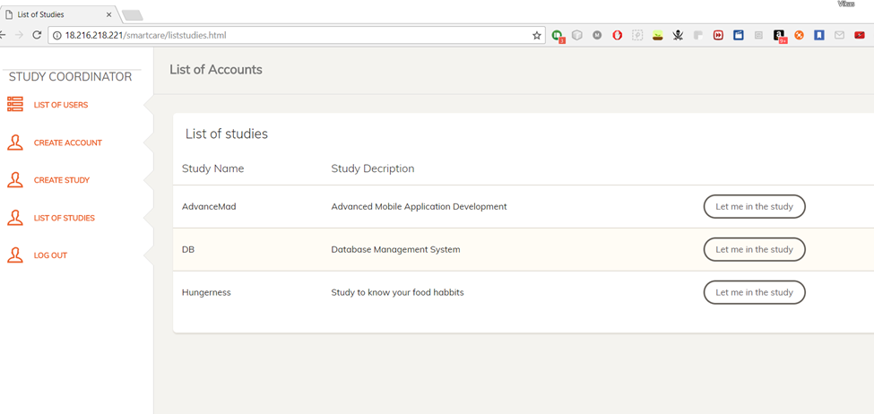
List of studies

Slide 20
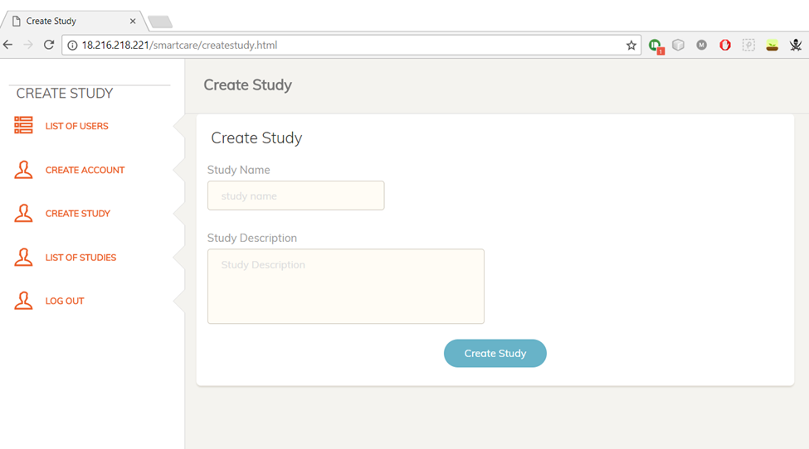
Design a new Study

Slide 21
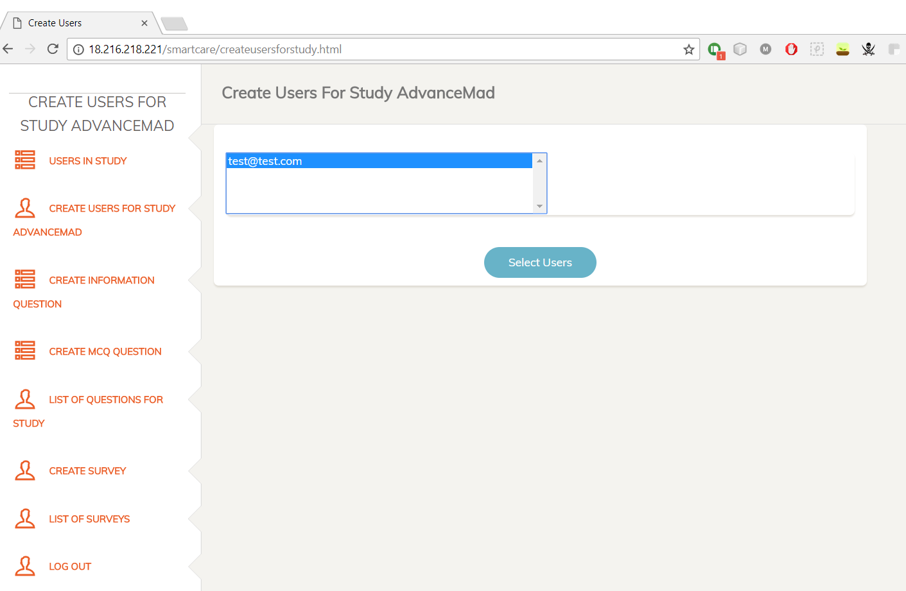
Adding users of the study

Slide 22
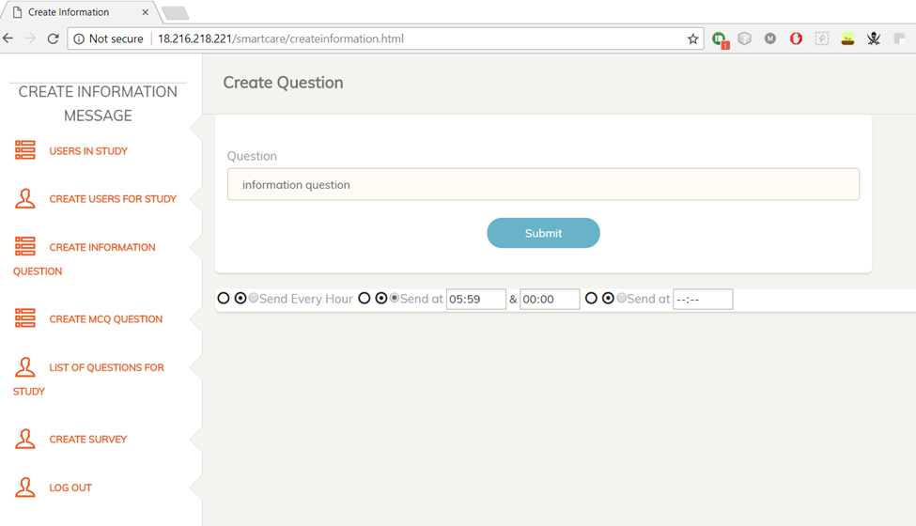
Creation of information message

Slide 23
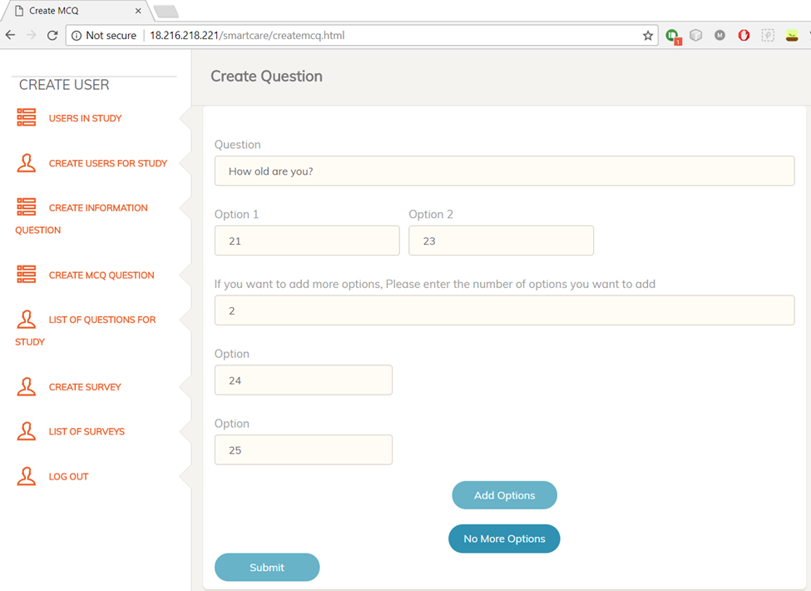
Creation of mcq question

Slide 24
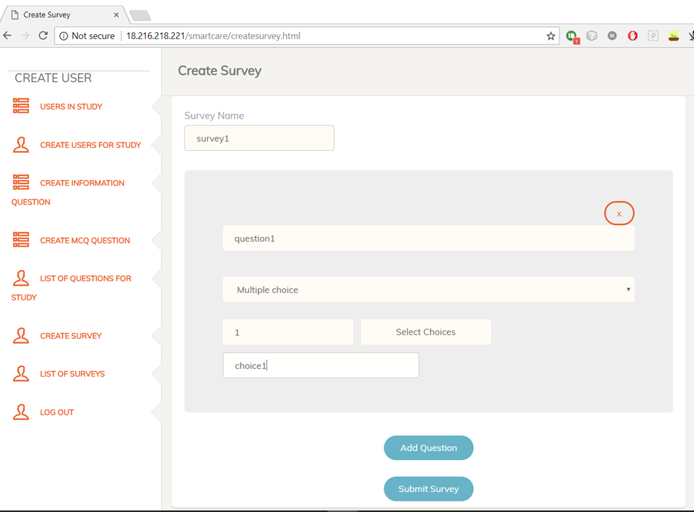
Creation of new survey

Slide 25
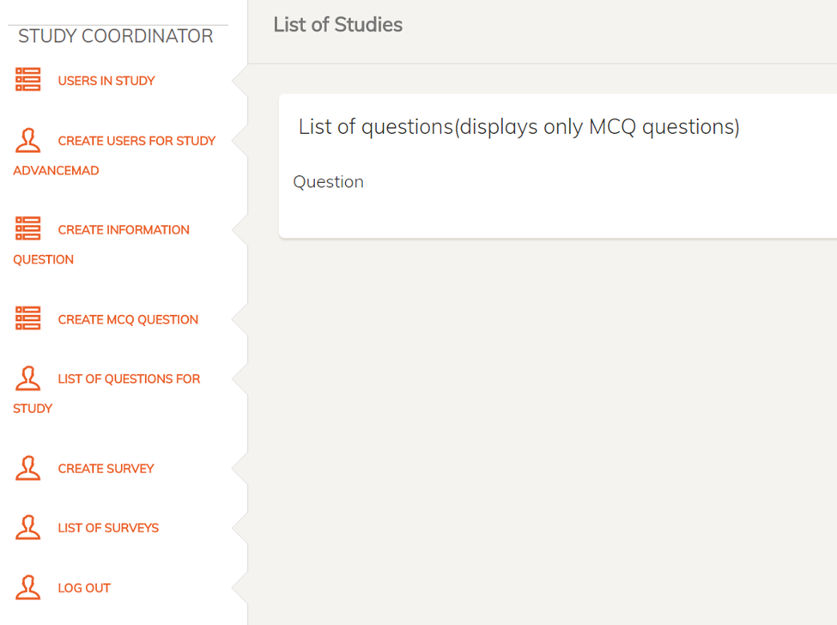
List of mcq questions

Slide 26
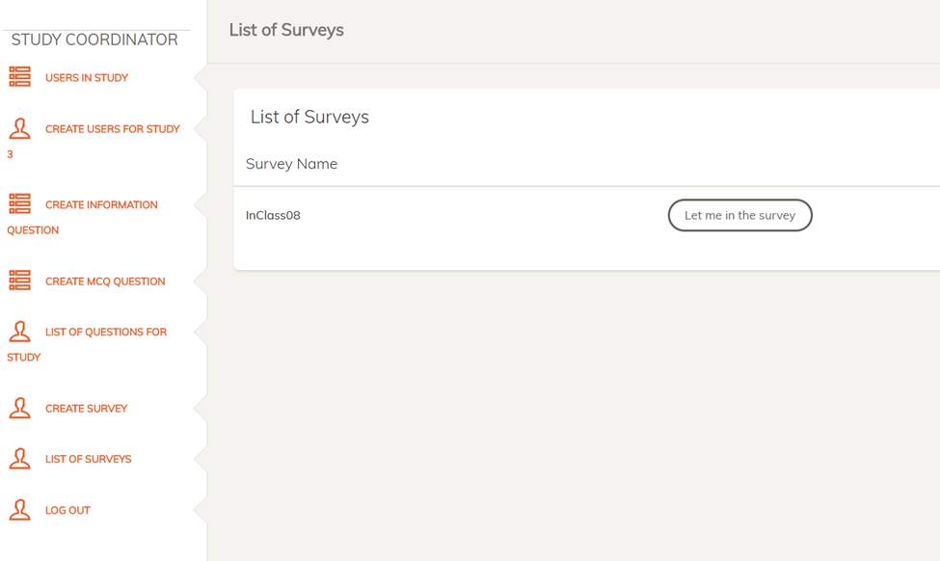
List of surveys

Slide 27
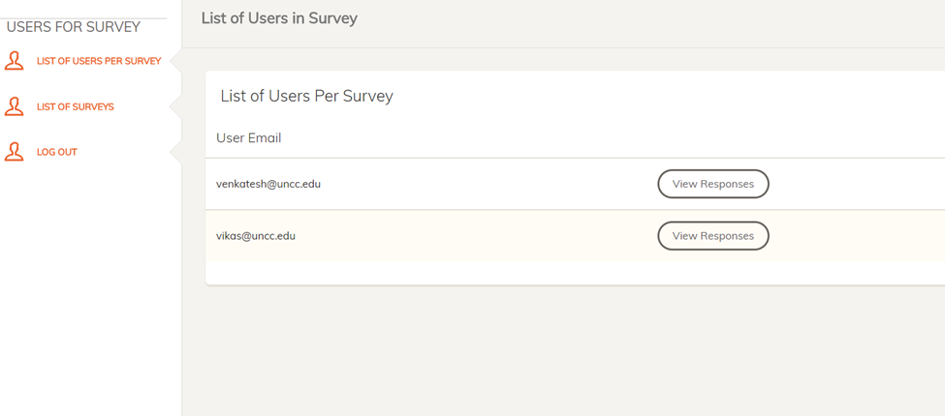
Lists of users in the study

Slide 28
Tasks Completed
Admin Tasks
Can create new user/patient
Can create new study co-Ordinator
Can view the list of existing users
Can view the list of existing study co-Ordinator
Study Co-Ordinator Tasks
Can create new user/patient
Can view the list of existing users
Can create a new study
Can view the list of existing studies
Can and the users to the created studies
Can design the study by adding the questions of both informative types and multiple choice questions
Created questions can be scheduled to be sent
Can create surveys in the studies with 3 types of questions open text, linkern type and multiple choice questions
Can view the responses of the questions provided by users.
Can view the responses of the surveys of each user
Can print the responses in the printable format.

Slide 29
Tasks Completed
Mobile Side Tasks
Will receive the notification once a new question is added to the study
Can opt-in or opt-out from receiving the notifications
Will list the list of studies that has been enrolled
Will show the list of questions in each study
Can submit the responses for each mcq questions
Can take the survey and submit the responses

Slide 30
Tasks not completed
Sending notifications on creation of a survey
Opening the study directly on clicking of the notification
Improvisation on UI

Slide 31
Thank you for your kind attention!

